Slide 1
Budget Infographics
Jupiter
Jupiter was named after a Roman god
1
2
3
4
Here is where this template begins
40%
60%
50%
80%
This template has been created by Slidesgo

Slide 2
Budget infographics
Mercury
Jupiter
Venus
Mars
Mercury is the closest planet to the Sun and is
very small
Jupiter was named after the Roman god of the skies
and lightning
Venus has a beautiful name and is the second planet from the Sun
Despite being red, Mars is actually a cold place. It’s full of iron oxide dust
$ 1500
$ 500
$ 750
$ 100
This template has been created by Slidesgo

Slide 3
Budget infographics
$ 100
Neptune is the eighth planet from the Sun
8%
$ 500
Saturn was named after a Roman god
35%
$ 800
Venus is the second planet from the Sun
57%
This template has been created by Slidesgo

Slide 4
Budget infographics
70%
80%
40%
90%
75%
1
2
3
4
5
Neptune is the eighth planet from the Sun
Earth is also known as the Blue Planet
Jupiter is the biggest planet of them all
Saturn was named after a Roman god
Venus is the second planet from the Sun
This template has been created by Slidesgo

Slide 5
Budget infographics
Earth is also known as the Blue Planet
60%
Saturn was named after a Roman god
30%
Jupiter doesn’t have a solid surface
10%
Venus is the second planet from the Sun
This template has been created by Slidesgo

Slide 6
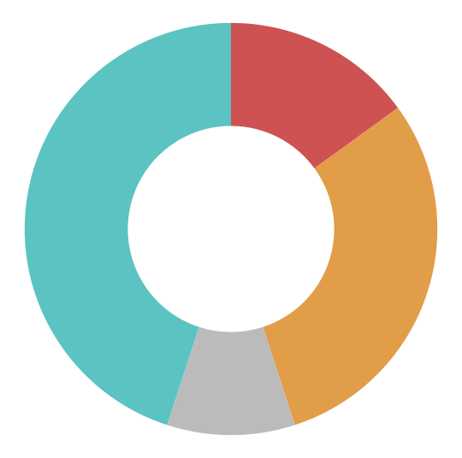
Budget infographics
Category
Amount
Neptune
$ 3500
Mars
$ 500
Saturn
$ 1500
Jupiter
$ 300
Jupiter was named after the Roman god of the skies and lightning
Follow the link in the graph to modify its data and then paste the new one here. For more info, click here
This template has been created by Slidesgo

Slide 7
Budget infographics
Earth
Mercury
30%
30%
Earth is the third planet from the Sun
Neptune is the farthest planet from the Sun
Mercury is the closest planet to the Sun
Saturn
20XX
Jupiter
30%
30%
Saturn was named after a Roman god
Jupiter was named after a Roman god
This template has been created by Slidesgo

Slide 8
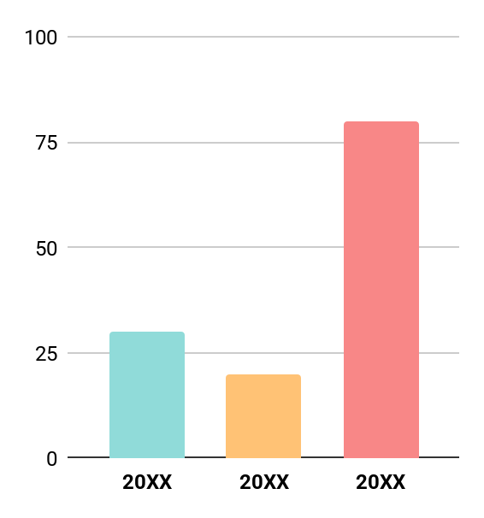
Budget infographics
Follow the link in the graph to modify its data and then paste the new one here. For more info, click here
1
2
3
Earth
Jupiter
Saturn
Earth is the third planet from the Sun
Earth is also known as the Blue Planet
Jupiter was named after a Roman god
Jupiter is the biggest planet of them all
Saturn was named after a Roman god
Saturn is a gas giant and has several rings
This template has been created by Slidesgo

Slide 9
Budget infographics
25%
5%
60%
10%
Mercury
Neptune
Earth
Jupiter
Saturn
Neptune is the fourth-largest planet in the Solar System
Earth is the third planet from the Sun and has life
Jupiter is a gas giant and has around
eighty moons
Saturn is the second-largest planet in the Solar System
This template has been created by Slidesgo

Slide 10
Budget infographics
Earth is also known as the Blue Planet
Earth
Neptune is the eighth planet from the Sun
Earth is the third planet from the Sun
Total budget
Jupiter is the biggest planet of them all
$100.00
Saturn was named after a Roman god
Venus is a hot planet
Mercury
Mercury is the closest planet to the Sun
Mars is full of iron oxide dust
This template has been created by Slidesgo

Slide 11
Budget infographics
Mars
Neptune
5%
Mars is full of iron oxide dust
Neptune is far away from Earth
20%
Jupiter
Saturn
15%
Jupiter doesn’t have a solid surface
Saturn was named after a Roman god
5%
Earth
Venus
30%
Earth is the planet on which we all live
Venus is the second planet from the Sun
35%
This template has been created by Slidesgo

Slide 12
Instructions for use
If you have a free account, in order to use this template, you must credit Slidesgo in your final presentation.
As a Free user, you are allowed to:
Modify this template
Use it for both personal and commercial projects
You are not allowed to:
Sublicense, sell or rent any of Slidesgo Content
Distribute Slidesgo Content unless it has been expressly authorized by Slidesgo
Include Slidesgo Content in an online or offline database or file
Offer Slidesgo templates (or modified versions of Slidesgo templates) for download
Acquire the copyright of
Slidesgo Content
For more information about editing slides, please read our FAQs or visit our blog

Slide 13
Instructions for use (premium users)
As a Premium user, you can use this template without attributing Slidesgo
You are allowed to:
Modify this template
Use it for both personal and commercial projects
Share this template in an
editable format
Hide or delete the “Thanks” slide and the mention to Slidesgo in the credits
You are not allowed to:
Sublicense, sell or rent any of Slidesgo Content
Distribute Slidesgo Content unless it has been expressly authorized by Slidesgo
Use any of the elements that are part in a separated way
Register any of the elements as a trademark or logo in an intellectual property registry
For more information about editing slides, please read our FAQs or visit our blog

Slide 14
Infographics
You can add and edit some infographics to your presentation to present your data in a visual way.
Choose your favourite infographic and insert it in your presentation using Ctrl C + Ctrl V or Cmd C + Cmd V in Mac
Remember to choose the “Keep source formatting” option so that it keeps the design. For more info, please visit our blog
01
07
Select one of the parts and ungroup it by right-clicking and choosing “Ungroup”
Repeat the steps above with the other parts and when you’re done editing, copy the end result and paste it into your presentation
02
06
03
Change the color by clicking
on the paint bucket
05
Group the elements again by selecting them, right-clicking and choosing “Group”
Then resize the element by clicking and dragging one of the square-shaped points of its bounding box (the cursor should look like a double-headed arrow). Remember to hold Shift while dragging to keep the proportions
04

